Slide 1

ESE_4009 Embedded Systems Design Project
Task: Interfacing Servo Motor
Submitted To: Prof. Mike Aleshams
Submitted by: Shubham Setia (c0752336)

Slide 2
Overview
This task is based on interfacing Servo Motor with BeagleBone Black
This project is called IOT Enabled Beaglebone based smart parking system with SMS alert.

Slide 3
List Of Hardware Components
Beaglebone Black
Ultrasonic sensors
RFID
WiFi module
Gsm Module
Servo motor
Buzzer
Voltage Regulator
Adapter
Soldering Iron Kit with Multimeter
Jumper wires and Bread Board

Slide 4
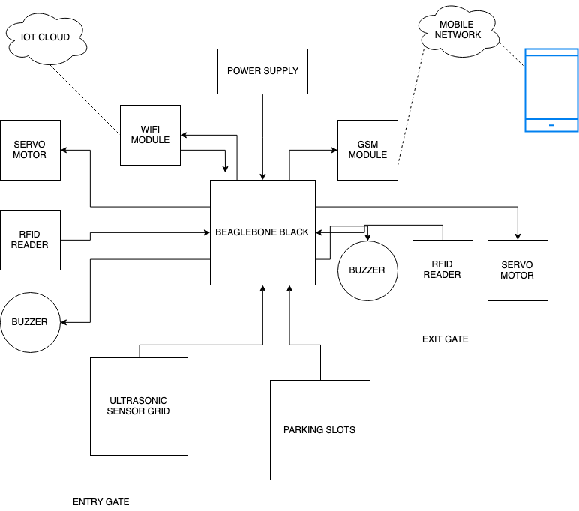
Project Block Diagram

Slide 5
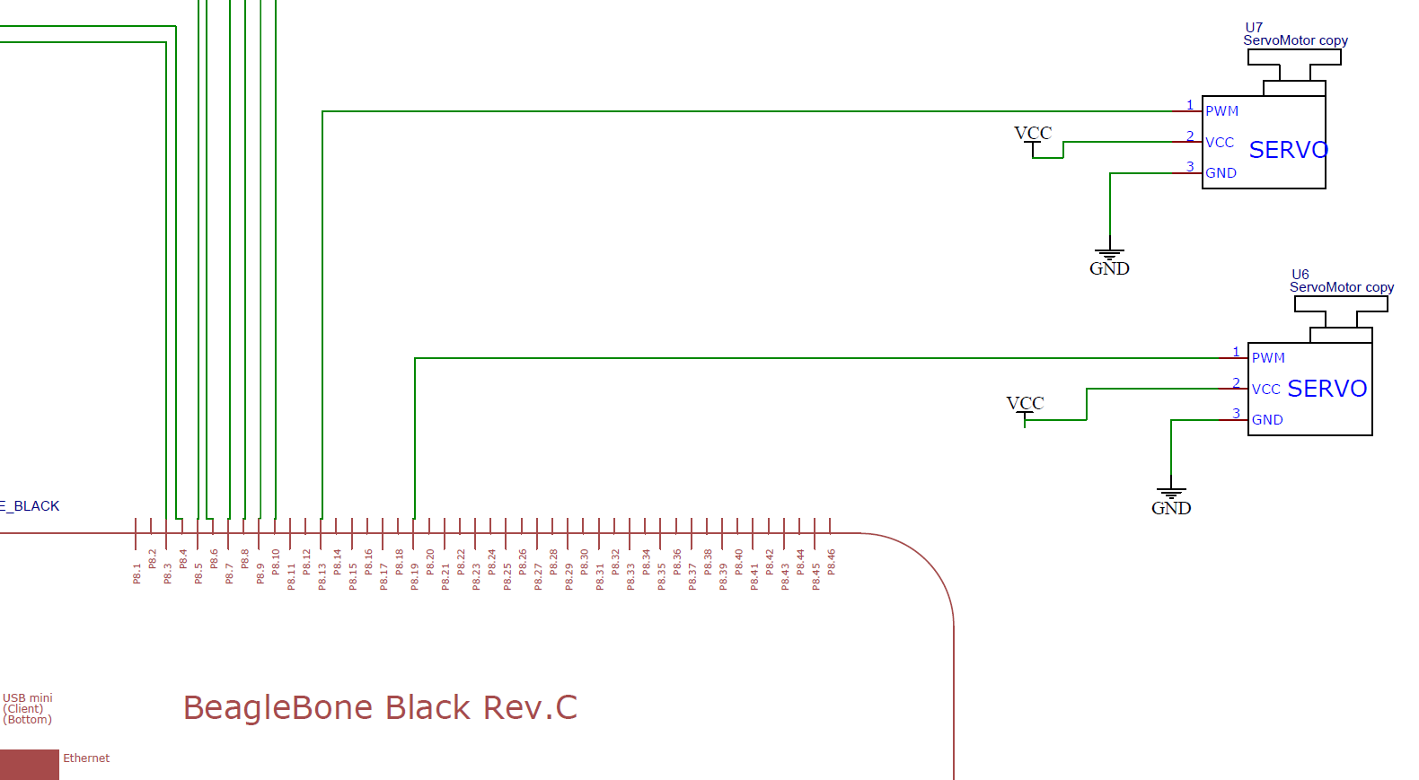
Schematics

Slide 6
Software Tools
Windows OS
PuTTY
GCC Compiler
Win SCP

Slide 7
Iobb Library
Iobb allows for easy general-purpose input/output (GPIO), SPI and I2C using the Beaglebone Black (BBB) and other BBB variants such as the BeagleBone Black Industrial and Beaglebone Black Wireless.
This library is also PocketBeagle friendly.
This library is designed to be easy-to-use, it is quite simple, and it allows for reasonably speedy I/O. There is plenty of demo source code too.

Slide 8
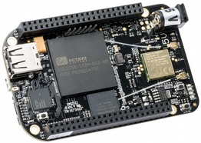
BeagleBone Black Rev C
It will be used as the main microcontroller. Box also includes a miniUSB to USB Type A cable. It is low cost, compact board used to build complex applications.
It is designed to fulfill requirements in fields such as gaming devices, home and industrial automation, consumer medical and intelligent machines and many more.

Slide 9
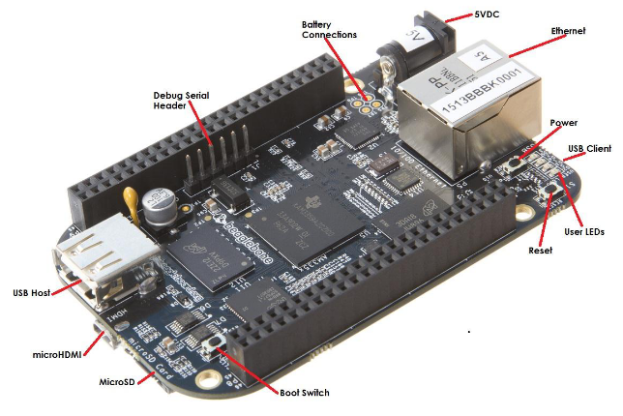
Specifications
Processor:
AM335x 1GHz ARM® Cortex-A8
512MB DDR3 RAM
4GB 8-bit eMMC on-board flash storage
3D graphics accelerator
NEON floating-point accelerator
2x PRU 32-bit microcontrollers

Slide 10
Software Compatibility
Debian
Android
Ubuntu
Cloud9 IDE on Node.js w/ BoneScript library

Slide 11

Connectivity
USB client for power & communications
USB host
Ethernet
HDMI
2x 46 pin headers

Slide 12

Interfacing Servo Motor- SG90

Slide 13
Servo Motor-SG90
Operating Voltage is +5V typically
Operating speed is 0.1s/60°
Rotation : 0°-180°
Package includes gear horns and screws
Used as actuators in many robots like Biped Robot, Hexapod, robotic arm etc..
Commonly used for steering system in RC toys
Robots where position control is required without feedback
Less weight hence used in multi DOF robots like humanoid robots

Slide 14
PuTTY
PuTTY is a free and open-source terminal emulator, serial console and network file transfer application.
It supports several network protocols, including SCP, SSH, Telnet, rlogin, and raw socket connection.
It can also connect to a serial port.
The name "PuTTY" has no official meaning.

Slide 15
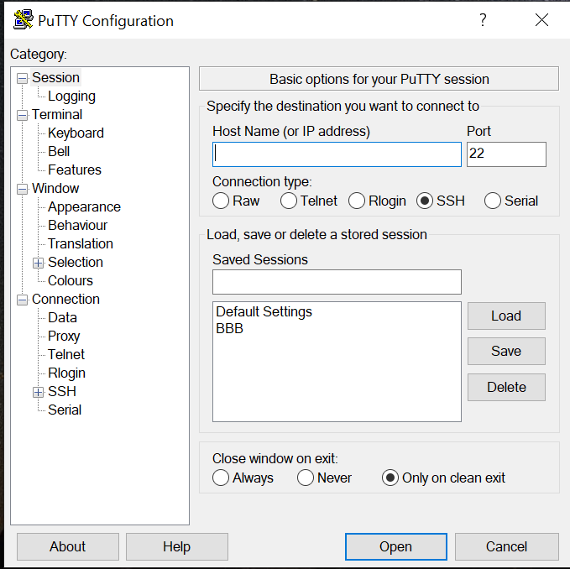
Connect to Beaglebone
PuTTY requires Host name or IP address of the machine we want to connect, the port number and the connection type.
For the connection, the host name will be 192.168.7.2
The port number is default 22
The connection type will be SSH

Slide 16
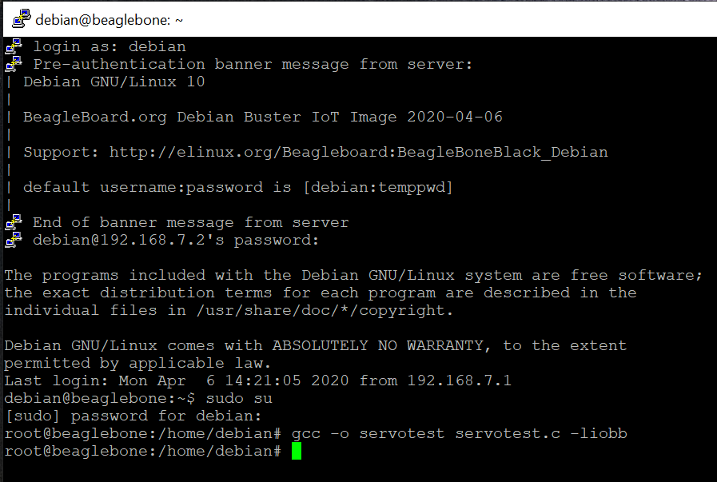
Program Execution
The program is made in the C language
The program is executed in the Debian
GCC compiler is used to compile the program
The commands used in the PuTTY are similar to those used in the Linux terminal as both are executed in the Debian.

Slide 17
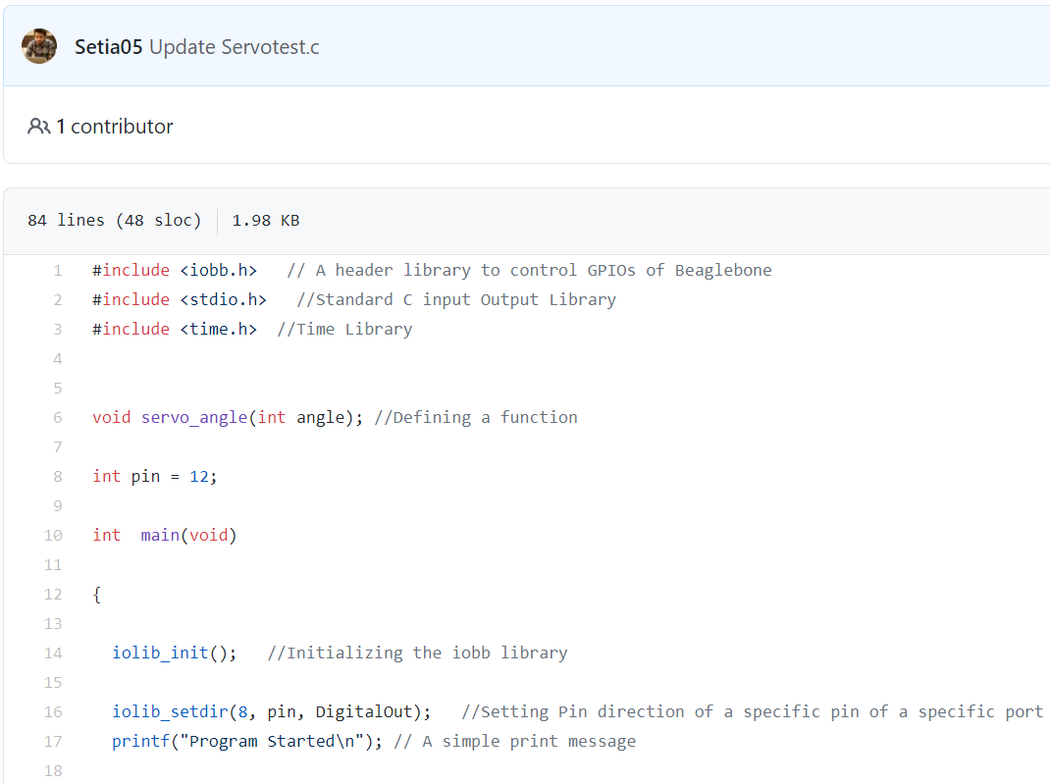
CODE

Slide 18
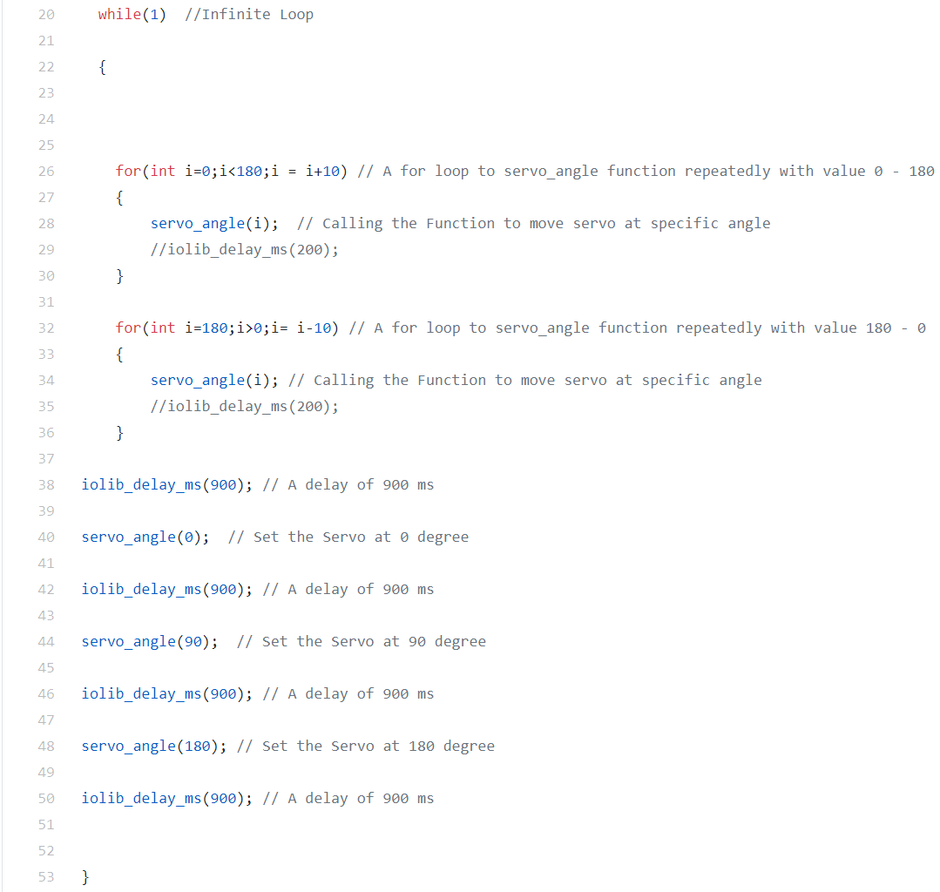
CODE (Cont.)

Slide 19
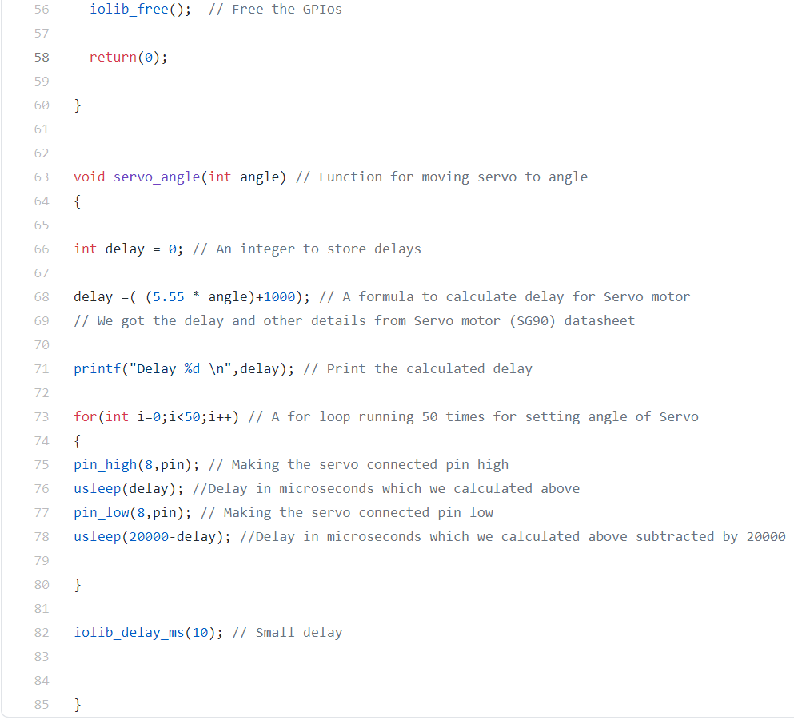
CODE (Cont.)

Slide 20

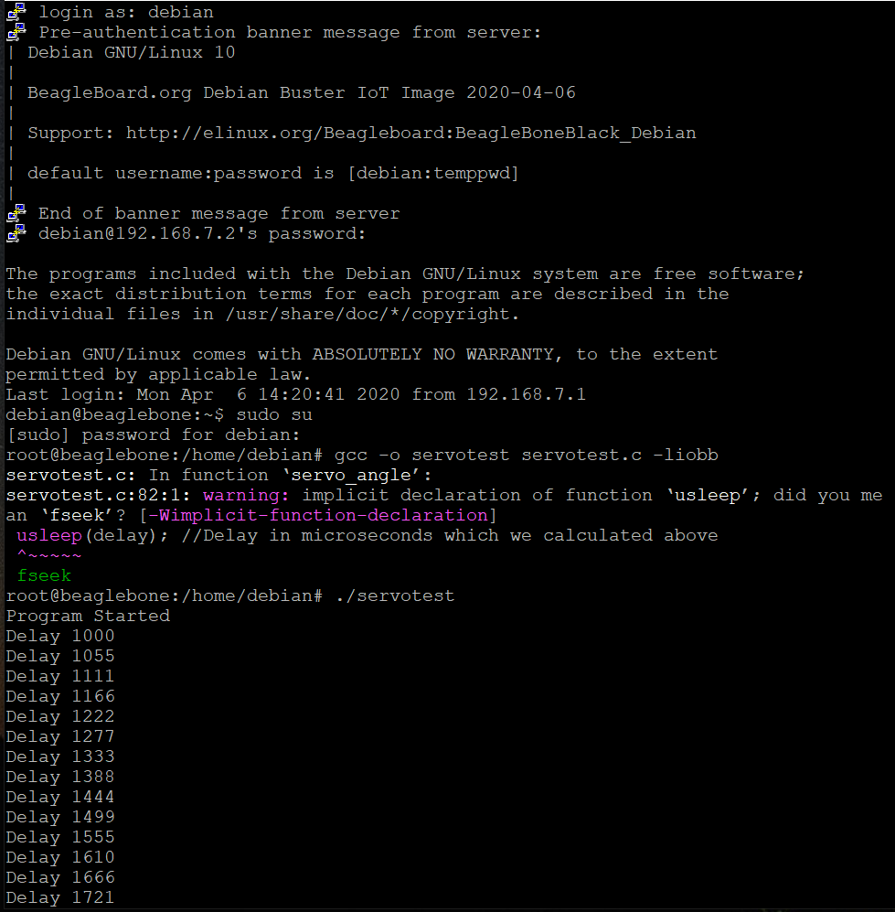
Result

Slide 21
WinSCP
WinSCP is an open source free SFTP client, FTP client, WebDAV client, S3 client and SCP client for Windows. Its main function is file transfer between a local and a remote computer.
Beyond this, WinSCP offers scripting and basic file manager functionality.

Slide 22
Features of WinSCP
Shares site settings with PuTTY
Graphical user interface (screenshots)
Translated into many languages
Integration with Windows (drag drop, URL, shortcut icons, jump list)
All common operations with files
Support for SFTP and SCP protocols over SSH and FTP and WebDAV and S3 protocols.

Slide 23
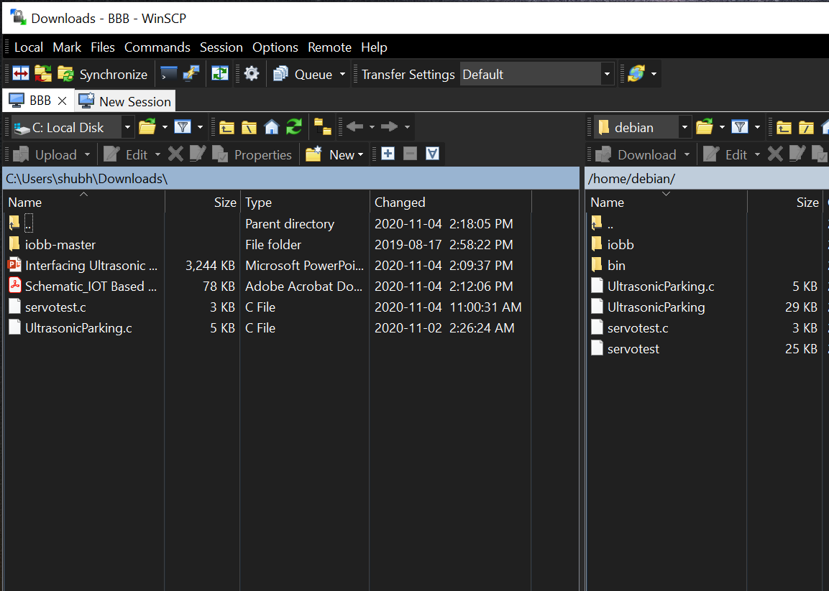
File Transfer
When you start WinSCP, the program will ask you for your login information. In most cases, you will only need to select the server’s protocol, enter the host name, username, and password, and then click Login.
The program will open a directory window like Windows File Explorer.

Slide 24
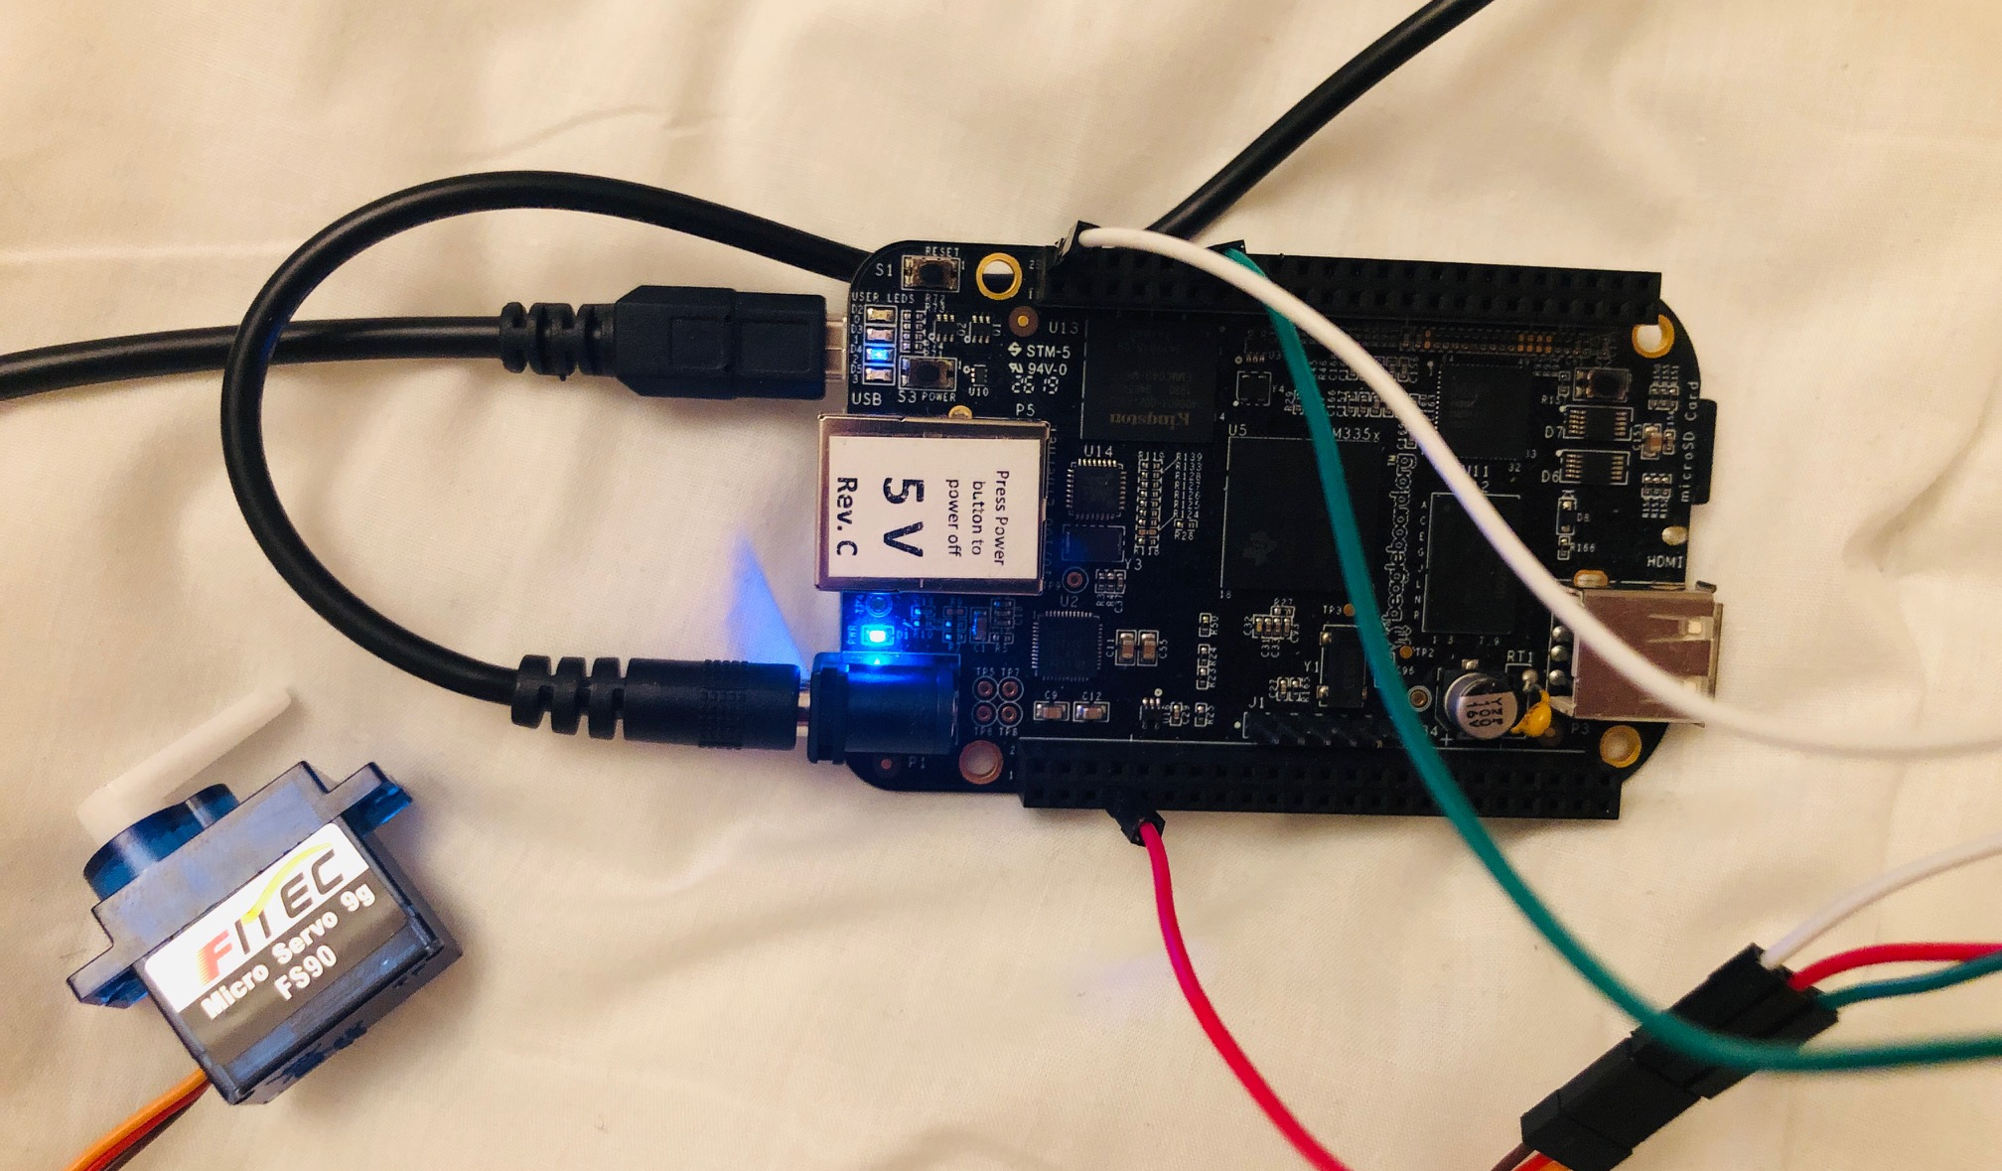
Interfacing

Slide 25
Pin Configuration
Servo Motor | BeagleBone Black
GND (Black) | DGND (P9_2)
+Vcc (Red) | SYS_5V (P9_8)
Signal (Yellow) | GPIO_44 (P8_12)
The interfacing of the servo motor with Beaglebone black is done through digital logic.
The pins of the servo motor are directly connected to the GPIO pins of the Beaglebone black.
To interface the motor; pins 2 and 8 of P9; pin 12 of P8 of the Beaglebone are used.
Pin 8 of P9 is used as the power supply to the motor.

Slide 26
Working
The input and output pins of the motor are connected to the Beaglebone.
The pins are also initialized in the C program.
Loops are used so that the motor works continuously.
The code is executed and run in the Beaglebone itself.

Slide 27
Issues while interfacing
As the jumper cables are not soldered yet, the output is sometimes irregular due to improper connection.
A lot of commands were to be used to move the iobb library and the code to the Beaglebone black. But, this drawback was later outcome by WinSCP.
If the computer restarts or shuts down, the PuTTY needs to be connected again and the commands are not saved as in Linux terminal.
We needed to flash the Beaglebone before interfacing.

Slide 28
Supporting Hardware
Adapter- An adapter or adaptor is a device that converts attributes of one electrical device or system to those of an otherwise incompatible device or system
Jumper wires (Male to male)

Slide 29
References
1. beaglebone black. (2019, September 06). Retrieved from beagleboard: https://beagleboard.org/black
2. Shabaz. (2019, August 15). iobb library. Retrieved from element14: https://www.element14.com/community/community/designcenter/single-board-computers/next-genbeaglebone/blog/2019/08/15/beaglebone-black-bbb-io-gpio-spi-and-i2c-library-for-c-2019-edition
3. https://winscp.net/eng/docs/start
4. https://github.com/shabaz123/iobb
5. https://www.putty.org/
6. http://www.ee.ic.ac.uk/pcheung/teaching/DE1_EE/stores/sg90_datasheet.pdf
7. https://www.youtube.com/watch?v=ceTYMgdfhRk

